Slide 1

Initial Robot Configuration
Team 13380
QUANTUM STINGERS

Slide 2
The Phones

Slide 3
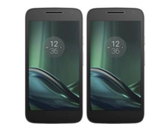
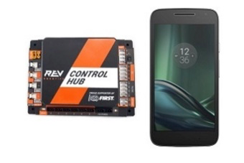
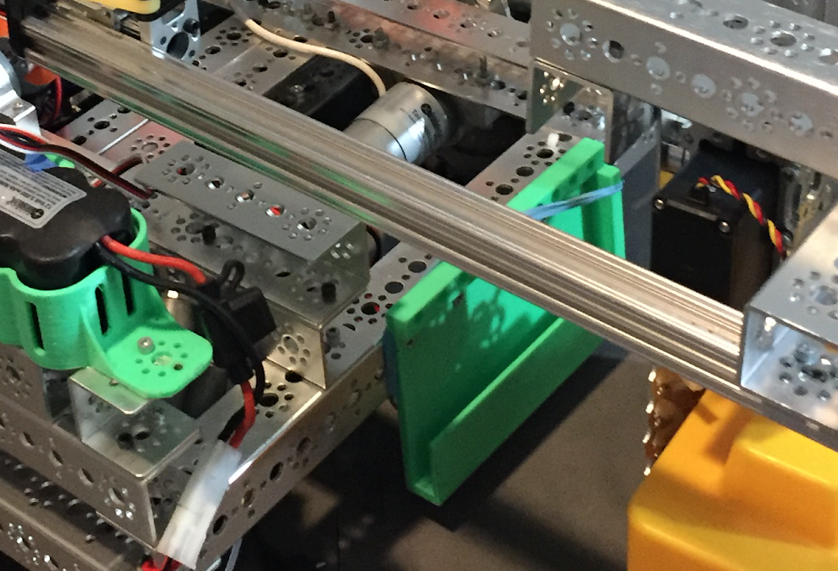
Phones for FTC
For FTC, every team/robot needs two Android phones
Starting with the 2020-2021 FTC Season, only Motorola Phones will be allowed (see a specific list in FTC Game Manual 1, page 33)
Two phones:
Driver Station Phone (DS)
Used by drivers/coach during robot game to start autonomous, etc.
Robot Controller Phone (RC)
Stays on robot, connected to Rev Hub (an alternative to this phone is using the Rev Control Hub)

Slide 4
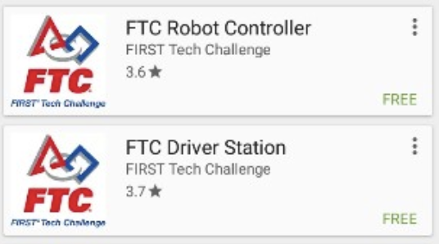
Setting Up the Phones
Steps to Setting Up
Rename the phone using the following format: “Team# - DS” for Driver Station and “Team# - RC” for Robot Controller
You can do this by going to Settings → Wifi → Advanced Wifi→ Wifi Direct → Configure Device
Install the FTC Driver Station App on the DS phone, which can be found through the Google Play Store, on the Driver Station Phone.
Similarly install the FTC Robot Controller App on the RC phone
For the next step, Pairing, make sure both phones are in Airplane mode but still keep the Wifi on

Slide 5
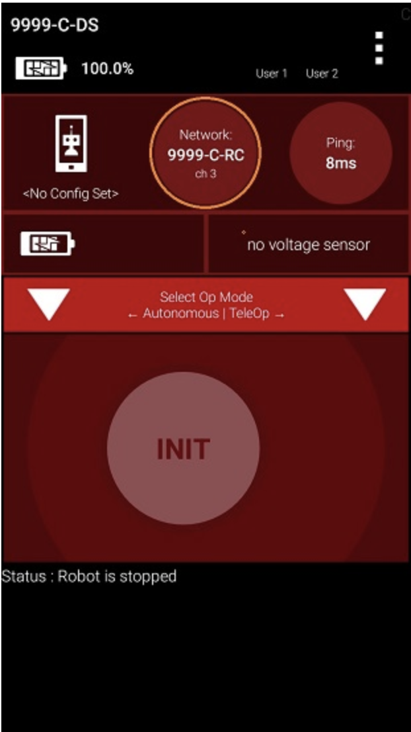
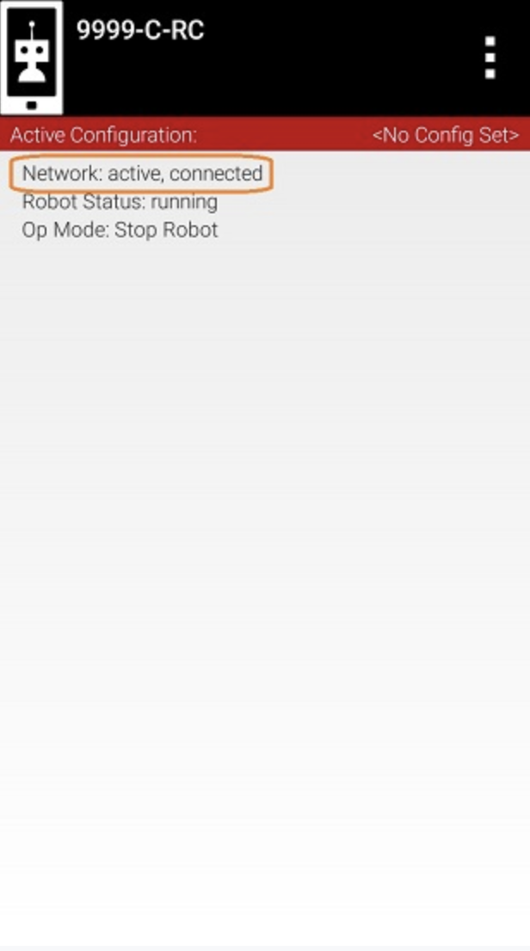
Pairing the Phones
This is how the DS app should look like →
Pairing the DS and RC phones will allow flow of telemetry data between phones, gamepad input, and selection of operation modes.
Steps to Pairing:
Verify that Robot Status is “Running” on the Robot Controller App on the RC phone
On the DS phone, launch the pairing: go to Driver Station App → the triple-dot pop-up menu → Settings → Pairing Method → Wifi Direct
Still under Settings → Pair with Robot Controller; then find and select your RC phone in the options (the name that you initially set the phone to should show up; if it doesn’t, check the wifi for the phones)
On the RC phone, accept the pairing in the Robot Controller App
This is how the RC app should ← look like

Slide 6
Rev Expansion Hub:

Slide 7
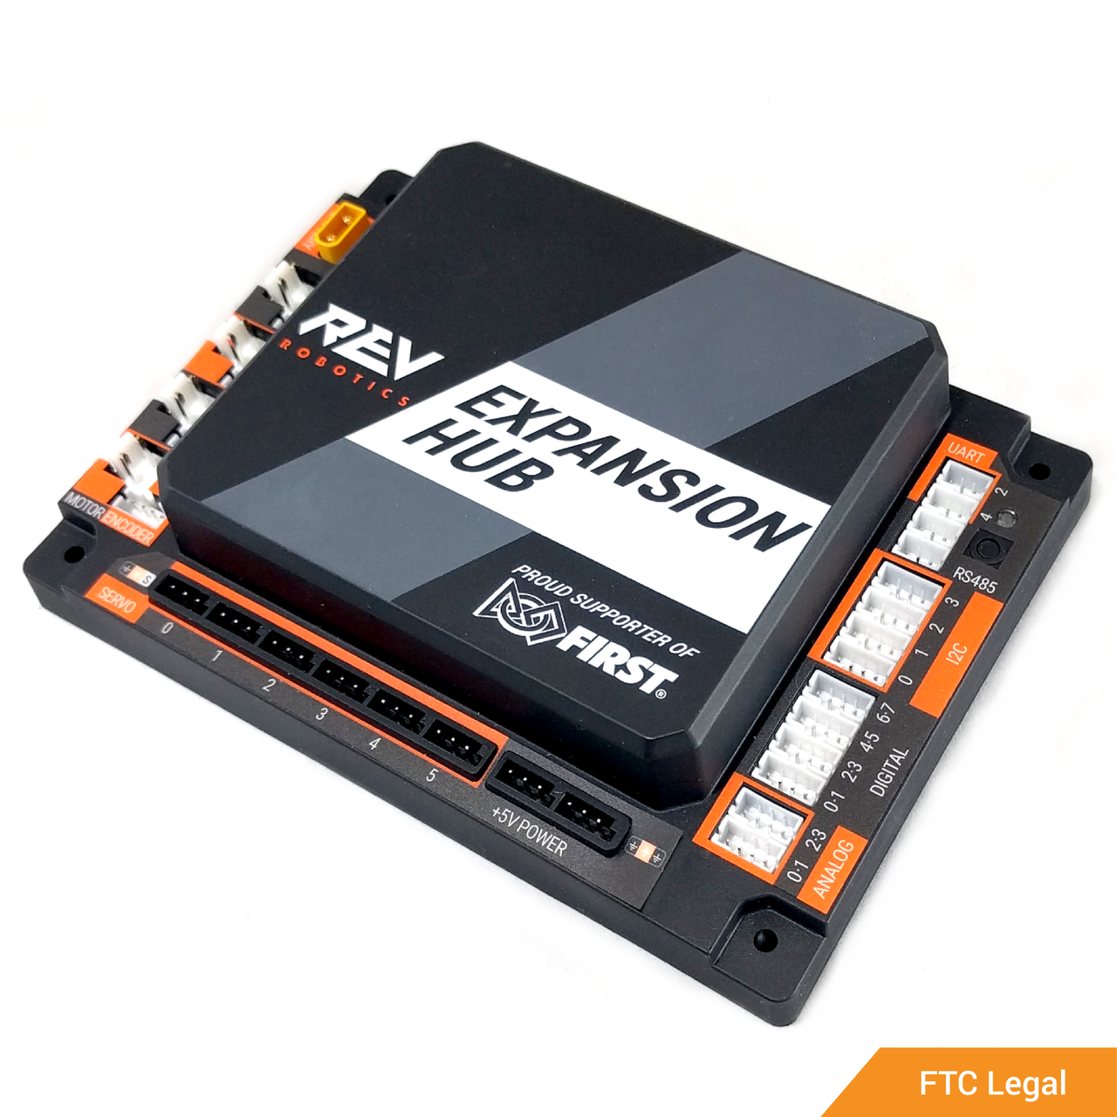
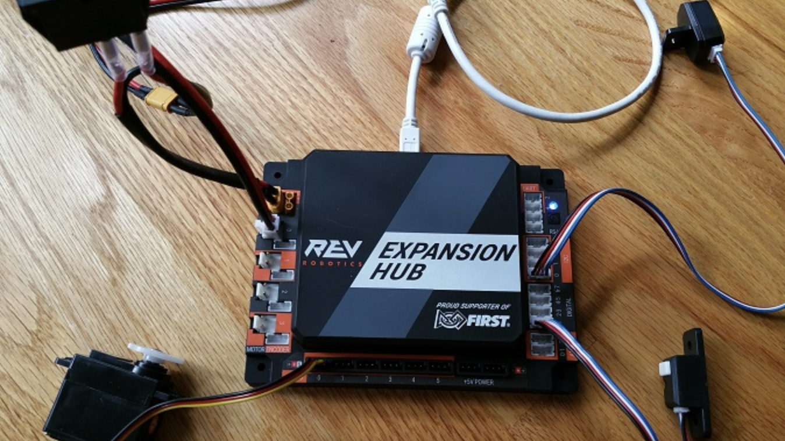
What is the Rev Expansion Hub?
A Rev Expansion Hub is the FIRST-approved control hub/port.
It is a hardware controller and interface that communicates between all the robot’s motors, servos, sensors, battery, robot switch, and the Robot Controller phone.
It has various external ports that are used to make these connections
The robot can have a maximum of 2 Rev Expansion Hubs

Slide 8
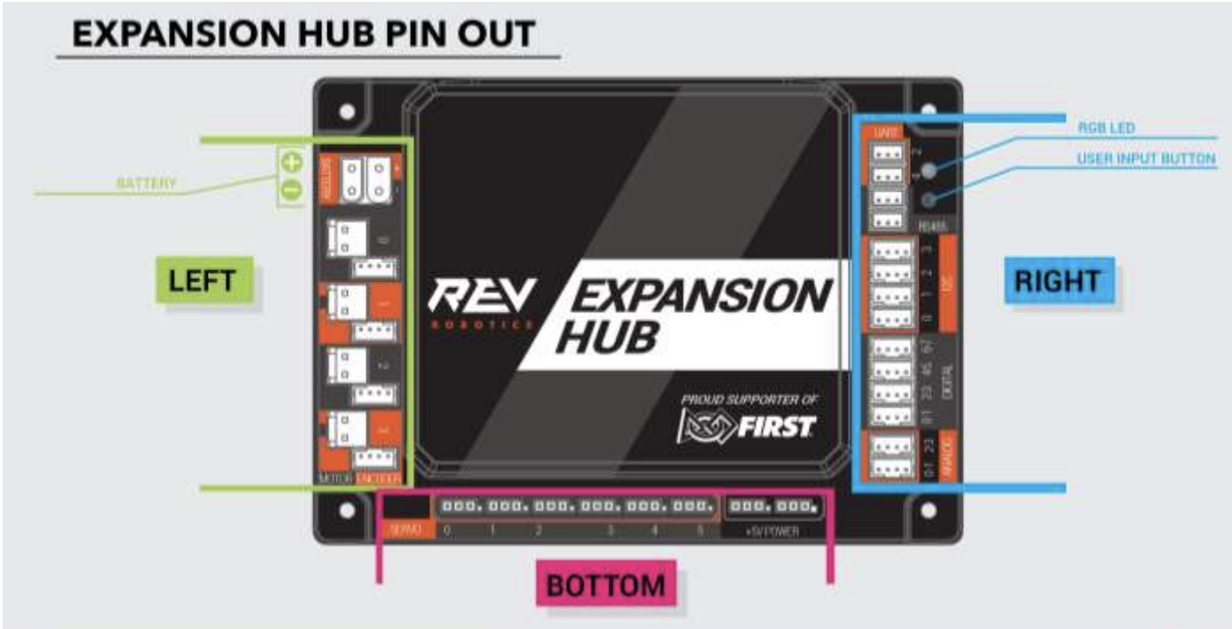
Rev Hub External Ports
^Mini USB Port (for phone)
Switch/ Battery→
XT30 Power ← Port
UART
RS485
← Hub to Hub
Connection
12C
← Color/Distance Sensor
Motors/ Encoders→
DIGITAL
← Touch Sensor
Analog
Servos^

Slide 9
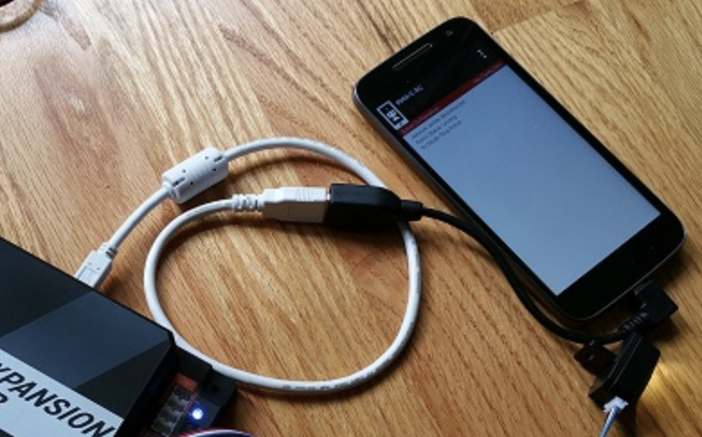
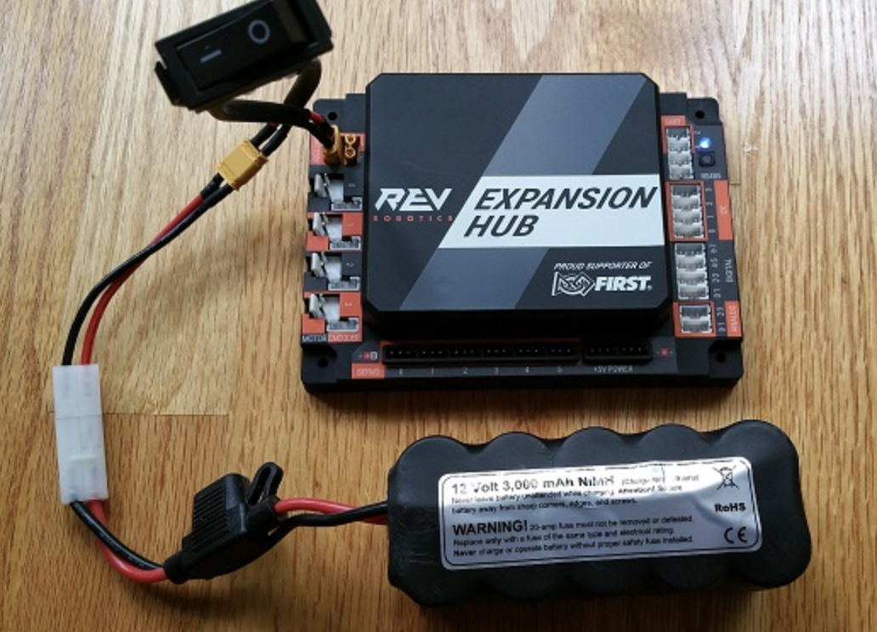
Making Connections
Rev Hub to RC Phone
USB Type A male to type B-mini male cable
Micro USB OTG adapter
Connect the USB type B-mini end to the Mini USB port on Rev Hub
Plug in the Type A end into the OTG adapter
Plug in the adapter to the RC phone
Rev Hub to the Battery/Switch
Rev Switch
Rev Tamiya to XT30 Adapter
12V Battery
Connect one of the Switch cables to the Adapter
Connect the Tamiya Adapter to that of the Battery
Connect the other end of the Switch to the top left battery port on the Rev Hub, as shown

Slide 10
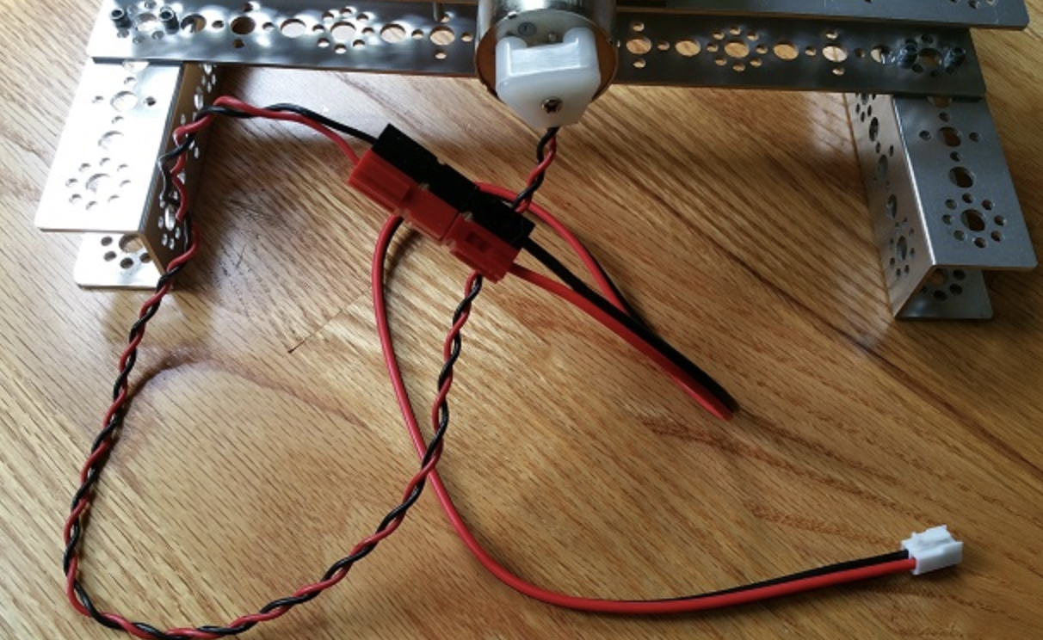
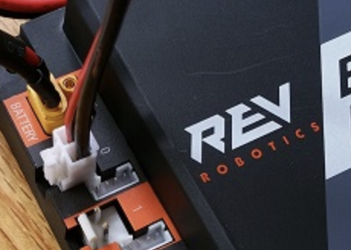
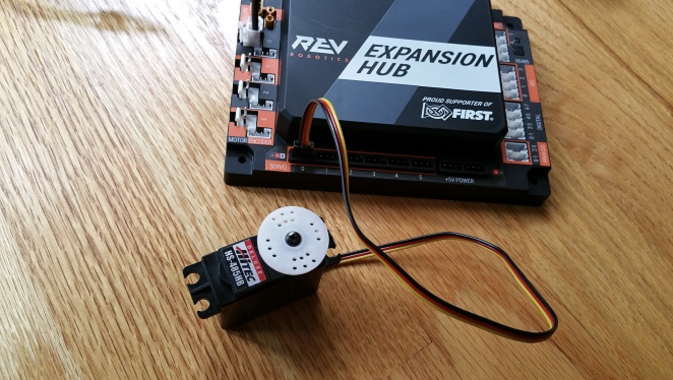
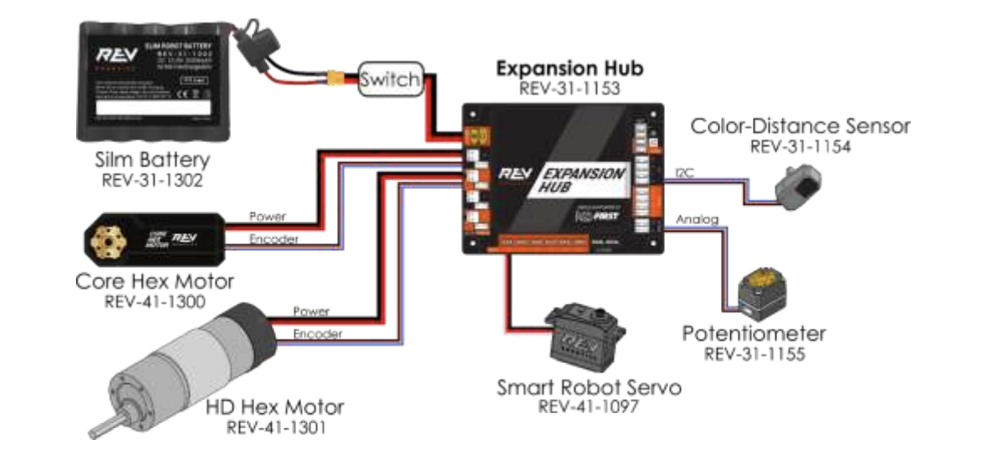
Connections Continued...
Anderson Powerpole →
Rev Hub to DC Motors
Anderson Powerpole to JST VH Adapter
Most of the DC motors should already have an Anderson Powerpole connector
Connect the motor’s Anderson Powerpole to that of the adapter
Plug in the Adapter to a Motor Port on the left side of the Expansion Hub, under the battery/switch
Encoders are plugged in to the small port directly next to where the corresponding motor is plugged into
Rev Hub to Servos
Just connect the 3-wire connector of the Servo to one of the Servo Ports at the bottom of the Rev Hub
Rev Hub to Sensors
Color Distance Sensors have 4-wire connectors that plug into the Ports labeled “12C” on the right side of the Rev Hub
Touch Sensors have 4-wire connectors that plug into the Ports labeled “Digital” on the right side of the Rev Hub
JST VH→
Motor →
← Encoder
Servo:
A full layout:

Slide 11
Rev Hub to Rev Hub Connection
One Rev Expansion Hub has 4 motor and 6 servo ports
For teams that use two Rev Hubs to accommodate for all the robot hardware, both Rev Hubs must be connected. Only one of the Rev Hubs will be connected to the RC phone.
Part 1
By default, all Rev Hubs have an equal, predefined serial address (2)
In order to connect two Rev Hubs, their addresses must be different, so one of them needs to be reconfigured
Connect one Rev Hub to the Robot Controller Phone and the Switch/Battery
Open RC App
Create a temporary configuration file
Go to Settings → Advanced Settings→ Expansion Hub Address Change
Now, change the current address from 2 to another value
Click Done
Delete the Temporary configuration file and create a new, permanent one

Slide 12
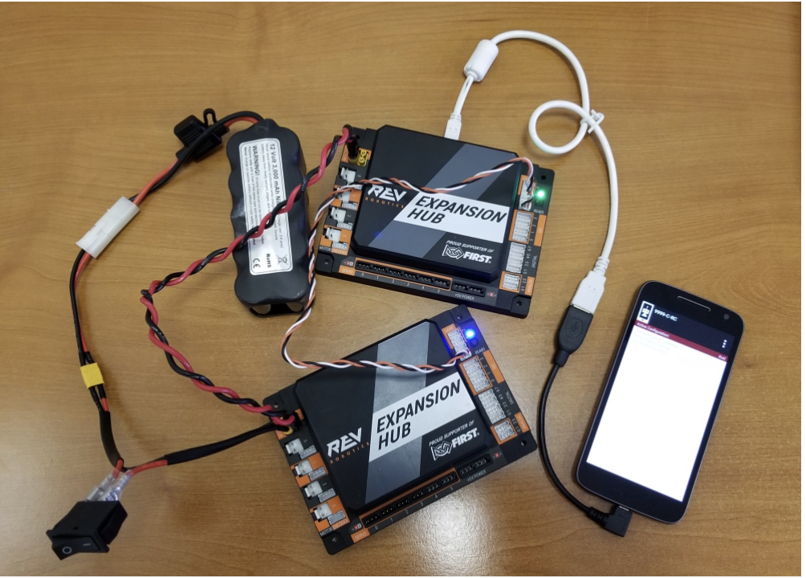
Rev Hub to Rev Hub Connection
Part 2: Wire Connections
Disconnect Rev Hub from phone and Battery/Switch
Use a XT30 Extension Cable → Plug into the XT30 Power ports of both Rev Hubs
Use a 3-pin JST PH Cable → Plug into RS485 Ports of both Rev Hubs
Connect one of the Rev Hubs to the RC Phone, and the other Rev Hub to the Switch/Battery
Make sure that both of these connections are made with only 1 continuous wire each (no extensions)
This is how it should look:
← JST Cable
XT30 Ext.

Slide 13
Robot Configuration

Slide 14
What is Robot Configuration?
To communicate with any motors, servos, or sensors wired to the Rev Hub’s external ports, you must configure them in your Robot Controller Phone
Configuration is based off of which hardware parts are connected to which Rev Hub Port
Every external port on the Rev Hub has a label (ex. Motor Port 1 or RS485 Port 2, etc.) This label is used to identify how the hardware is connected to the Rev Hub
The hardware parts (motors, servos, sensors) should also be named (ex. Back_Left_Motor); this name should be consistent with your code
Configuration is done on the Robot Controller Phone
The Phone must be physically connected to the Rev Expansion Hub(s)
The robot must be configured in order to run any programs

Slide 15

Steps to Configuration
Steps to Configuration:
Physically connect RC phone to the Rev Hub
Go to the Robot Controller App
Click on triple-dot for the drop down menu
Click “Configure Robot”
For the first-ever Configuration
Click New
Click Scan to find all connected Rev Hubs
Click on the Rev Hub that you want to configure
Now you should be able to a list of ports
Click on the one you want to configure (ex. motors)
Now you will see a list of ports (0,1,2,3...)
Under the corresponding port, click the drop-down menu and select the correct robot part type
Make sure that your configuration matches the actual connections on the Rev Hub
For example, if Back_Left_Motor is plugged into Motors Port 0 of Rev Hub1, type “Back_Left_Motor” in Rev Expansion Hub Portal 1 → Motors → Port 0
After configuring all hardware parts, click Done → Save

Slide 16
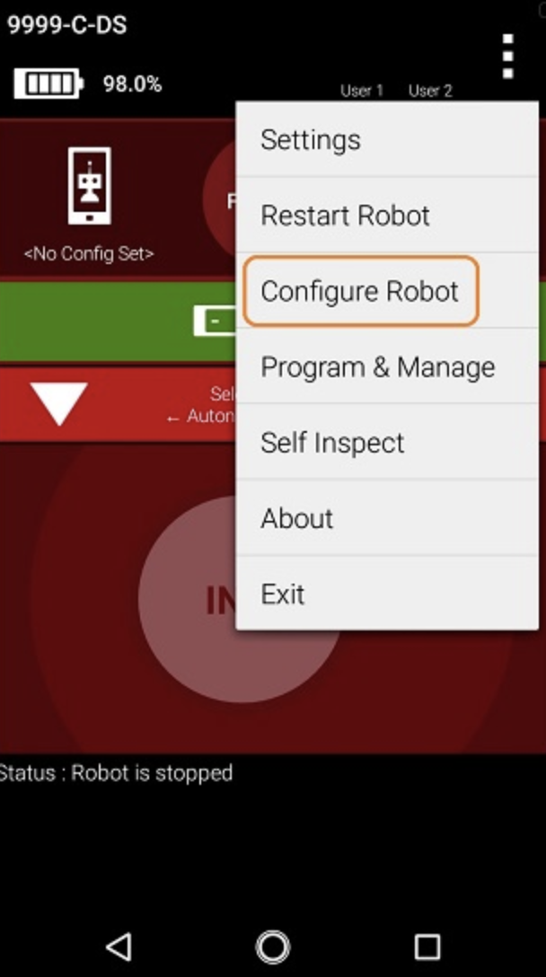
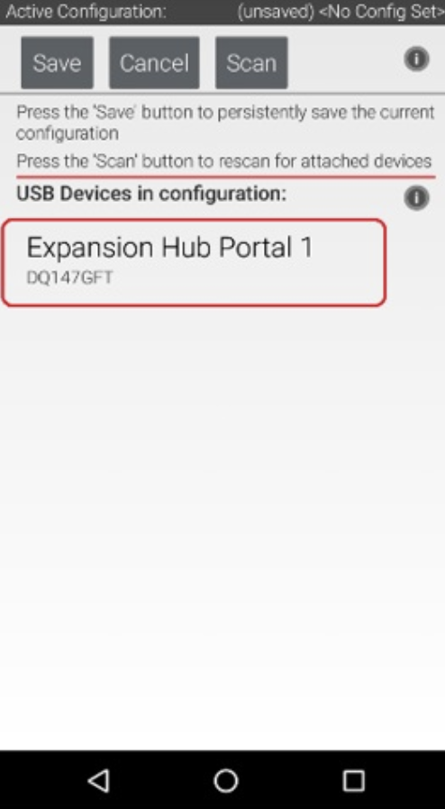
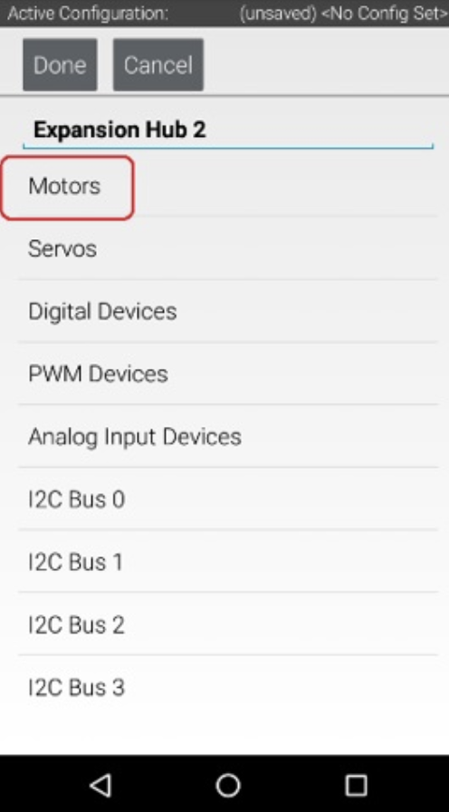
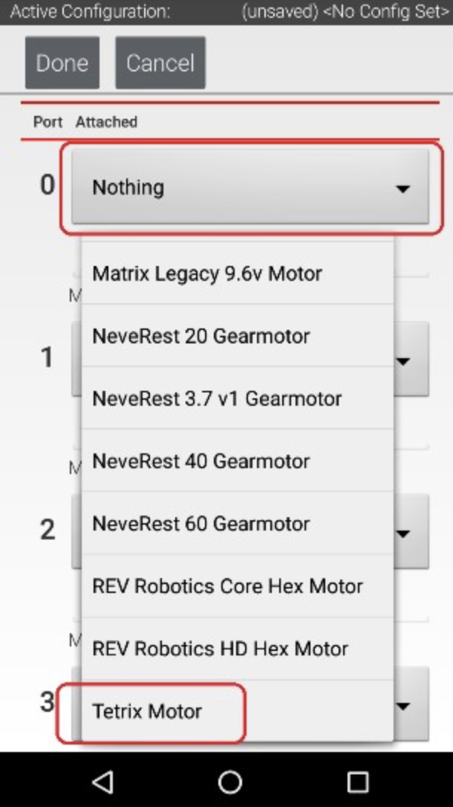
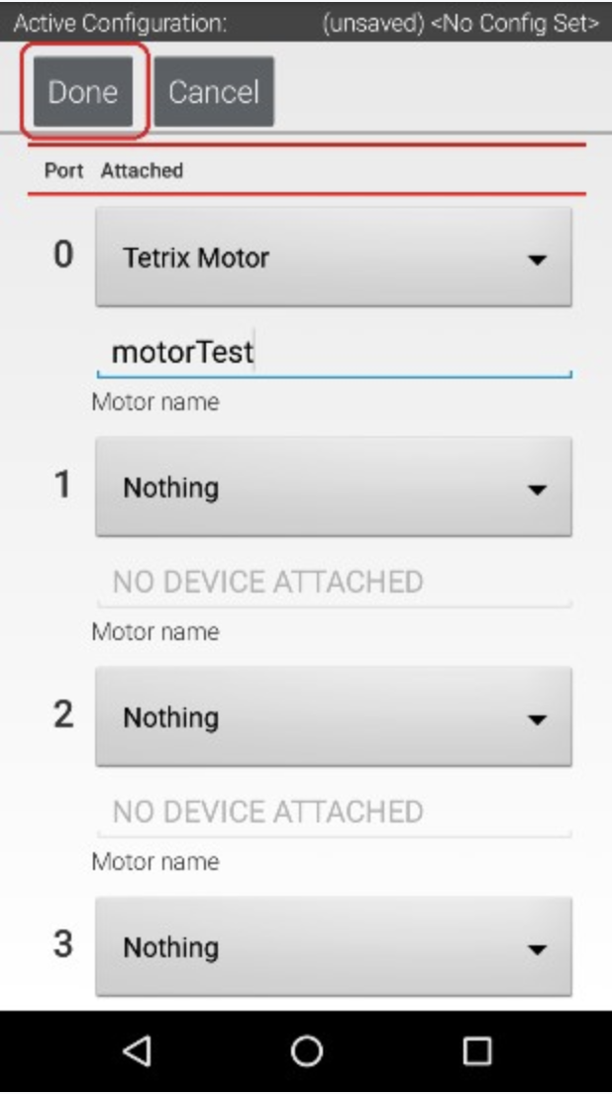
Steps to Configuration:

Slide 17

Credits
This lesson was written by Vennela Jonnala of Team 13380 (Quantum Stingers) for FTCTutorials.com
You can contact the author at vennelashriya@gmail.com
More lessons for FIRST Tech Challenge are available at www.FTCtutorials.com
This work is licensed under a
Creative Commons Attribution-NonCommercial-ShareAlike 4.0 International License.

